Slide 1

SWS3009
Lecture 1
Classification and Regression Networks
colintan@nus.edu.sg

Slide 2
Motivation
In the Trial Lecture we looked at neural networks:
Unsupervised and supervised techniques.
Selection of hyperparameters.
Overfitting.
The neural networks of the previous lecture have an issue:
The uniform, fully connected layers mean that there are many many parameters to train.
Compounded by complex data requiring more complex layers.
“Curse of dimensionality” means that we need exponentially more data to train these parameters – and data is hard to get.
We have a tough tradeoff between the learning ability of the neural network, and overfitting.

Slide 3
Motivation
Deep learning neural networks are designed to address these constraints:
Consist of many layers, hence “deep”.
Layers may not be uniform, and can have different functions. E.g. act as filters, feature extractors, etc.
These transform and simplify the data so that less dense networks can be used to learn them.
We will divide our networks into two types:
Lecture 1: Classification and regression networks.
The “bread and butter” networks for robotics and ioT.
Lecture 2: Generative Networks
Cutting edge networks with less relevance towards robotics and IoT
Nonetheless can be used for very interesting applications.

Slide 4
Motivation
Lecture 1: Classification and Regression Deep Learning Networks
Long-Short Term Memory (LSTMs)
Transformer Models
Convolutional Neural Networks (CNNs)
Object Detection Networks (YOLO)
Lecture 2: Generative Deep Learning Networks
Autoencoders and Variational Autoencoders
Generative Adversarial Networks (GANs)
Diffusion Models

Slide 5
Long-Short-term memories (lstm)
SWS3009 Embedded Systems and Deep Learning.

Slide 6
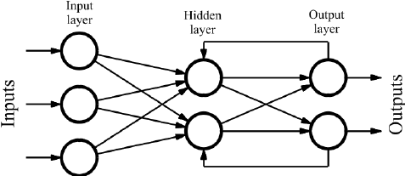
Deep Learning Recurrent Neural Networks
Key issue with MLPs:
When we present training data we assume that all the samples are independent.
This is often WRONG:
E.g. the word “often” above usually follows “is” or “are”. Likewise “is” or “are” often follows “this”. THEY ARE NOT INDEPENDENT!
Solution:
Use past (and sometimes future) information to learn with current data.
In RNNs we feed the output of the MLP back to the hidden layer (and maybe backwards to previous hidden layers)

Slide 7
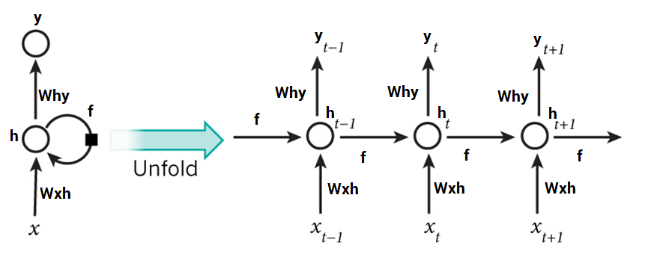
Deep Learning Recurrent Neural Networks
One popular technique to train recurrent neural networks is “backpropagation through time” or BPTT.
Unroll the neural network in time for X time-steps to form a deep network:
Apply standard backpropagation
We see that learning each new piece of data is now affected by past pieces.

Slide 8
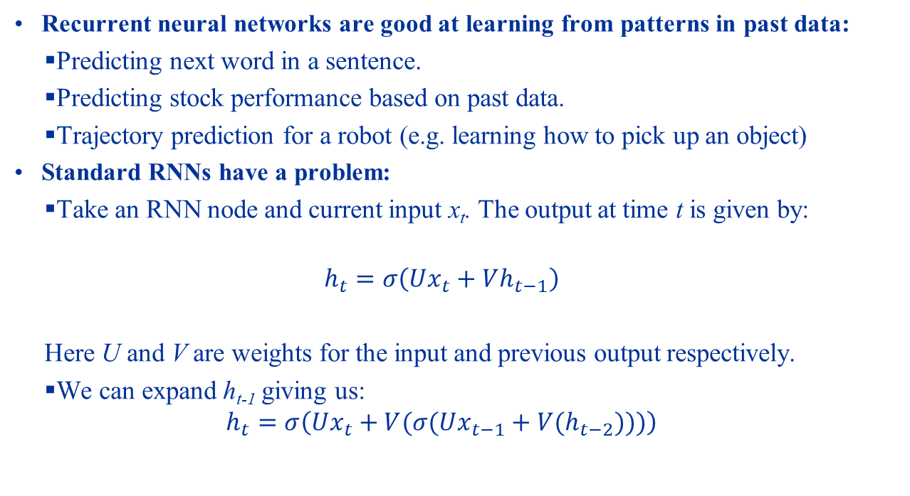
Deep Learning Recurrent Neural Networks
Recurrent neural networks are good at learning from patterns in past data:
Predicting next word in a sentence.
Predicting stock performance based on past data.
Trajectory prediction for a robot (e.g. learning how to pick up an object)
Standard RNNs have a problem:
Take an RNN node and current input x_{t}. The output at time t is given by:
$$h_{t}=σ\left(Ux_{t}+Vh_{t−1}\right)$$
Here U and V are weights for the input and previous output respectively.
We can expand h_{t-1} giving us:
$$h_{t}=σ\left(Ux_{t}+V{(σ(Ux_{t−1}+V(h}_{t−2})))\right)$$

Slide 9
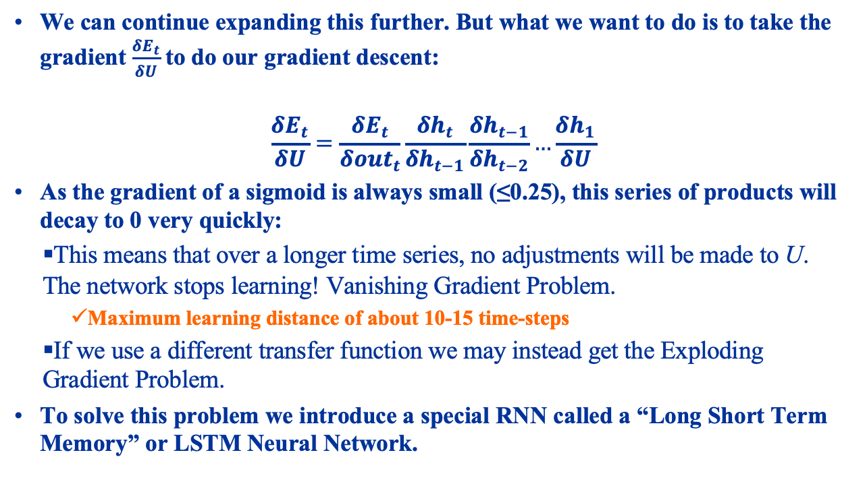
Deep Learning Recurrent Neural Networks
We can continue expanding this further. But what we want to do is to take the gradient $\frac{δE_{t}}{δU}$to do our gradient descent:
$$\frac{δE_{t}}{δU}=\frac{δE_{t}}{δ{out}_{t}}\frac{δh_{t}}{δh_{t−1}}\frac{δh_{t−1}}{δh_{t−2}}…\frac{δh_{1}}{δU}$$
As the gradient of a sigmoid is always small (≤0.25), this series of products will decay to 0 very quickly:
This means that over a longer time series, no adjustments will be made to U. The network stops learning! Vanishing Gradient Problem.
Maximum learning distance of about 10-15 time-steps
If we use a different transfer function we may instead get the Exploding Gradient Problem.
To solve this problem we introduce a special RNN called a “Long Short Term Memory” or LSTM Neural Network.

Slide 10
Deep Learning Recurrent Neural Networks
The issue is that the error gradients either become very small – vanishing – or very large – exploding.
Errors either shrink or grow across time steps.
The solution then is to maintain a (near) constant gradient across time-steps so errors neither grow now shrink:
在多个时间步中保持梯度近似恒定，使误差不会爆炸也不会消失
Constant Error Carousel.
This is the basis of Long Short-Term Memory or LSTM.

Slide 11
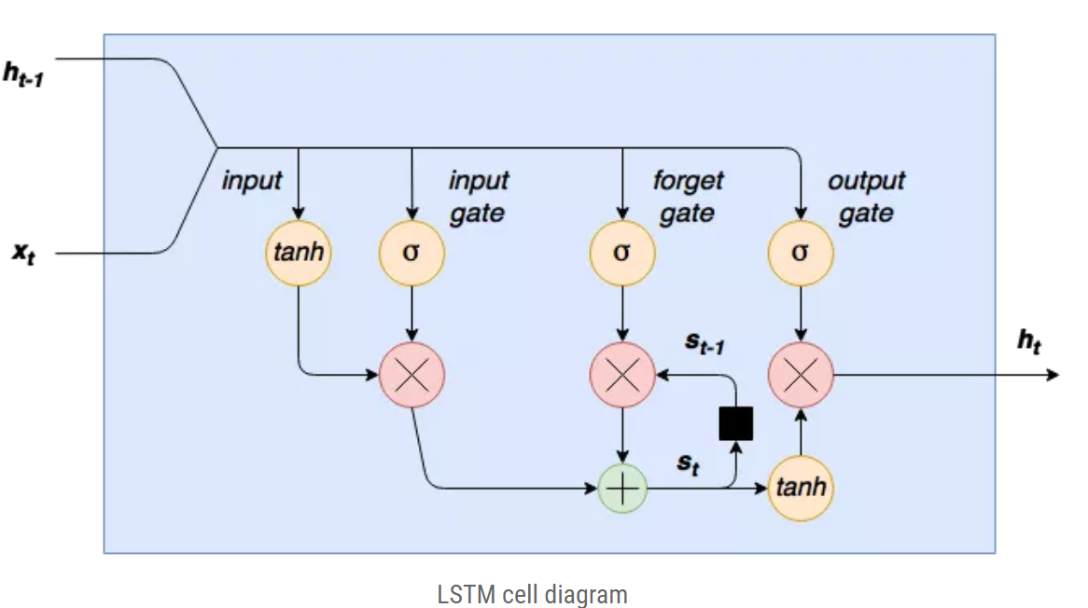
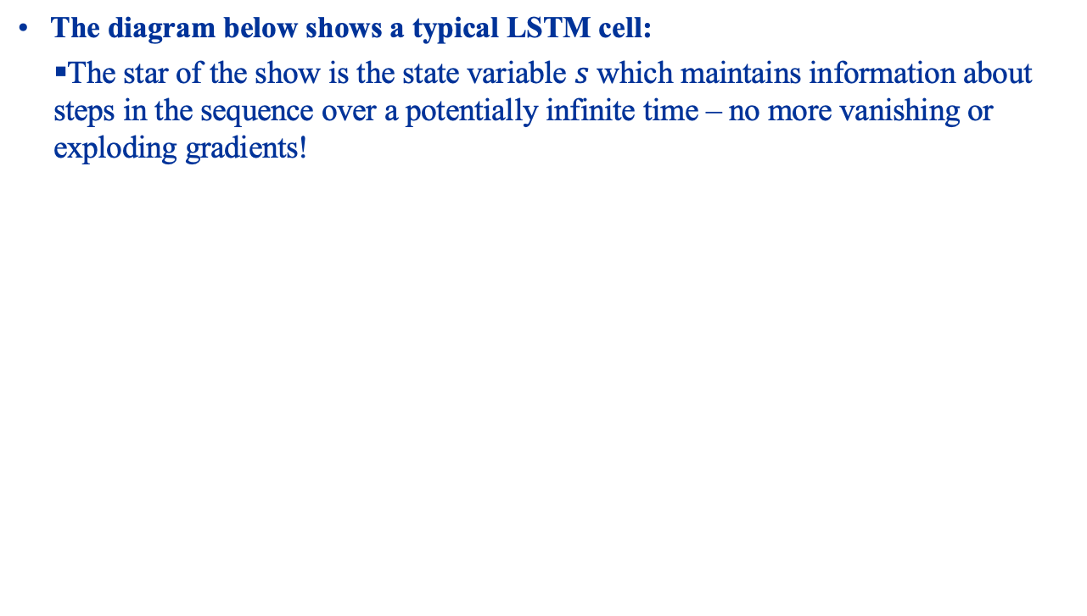
LSTM Cell
The diagram below shows a typical LSTM cell:
The star of the show is the state variable $s$ which maintains information about steps in the sequence over a potentially infinite time – no more vanishing or exploding gradients!

Slide 12
LSTM Cell Input Stage
Learning in the LSTM is controlled through three gates:
Every gate is a neural network that is trained using gradient descent.
The first gate is the input gate:
Controls whether the current input can alter the stored state of the cell.

Slide 13
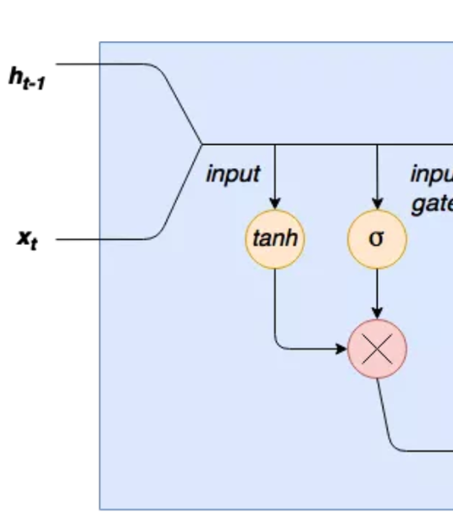
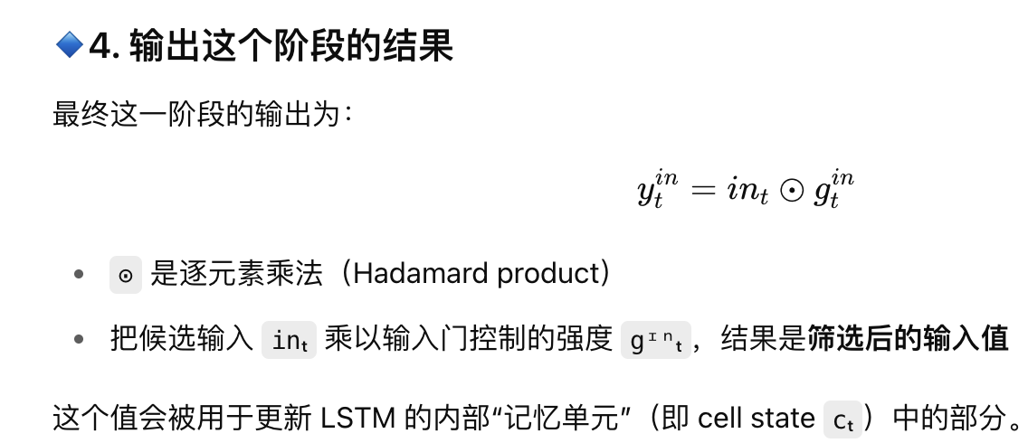
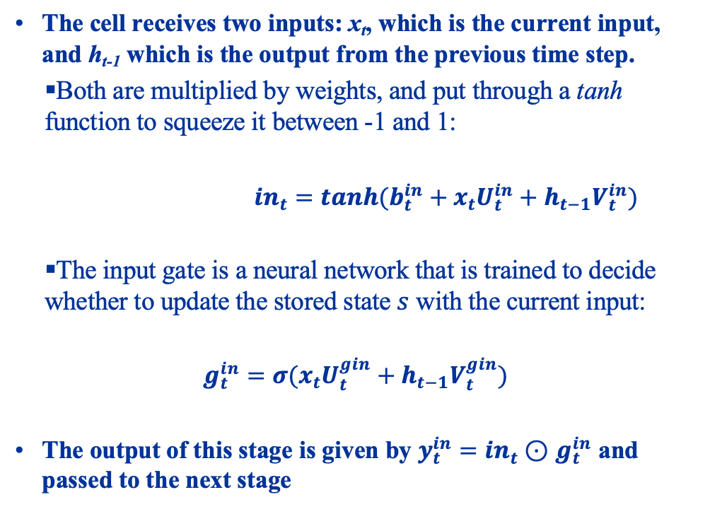
LSTM Cell Input Stage
The cell receives two inputs: x_{t}, which is the current input, and h_{t-1} which is the output from the previous time step.
Both are multiplied by weights, and put through a tanh function to squeeze it between -1 and 1:
${in}_{t}=tanh(b_{t}^{in}+x_{t}U_{t}^{in}+h_{t−1}V_{t}^{in})$
The input gate is a neural network that is trained to decide whether to update the stored state $s$ with the current input:
$$g_{t}^{in}=σ(x_{t}U_{t}^{gin}+h_{t−1}V_{t}^{gin})$$
The output of this stage is given by $y_{t}^{in}={in}_{t}⊙$ $g_{t}^{in}$ and passed to the next stage

Slide 14
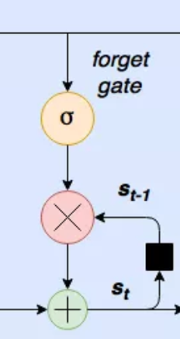
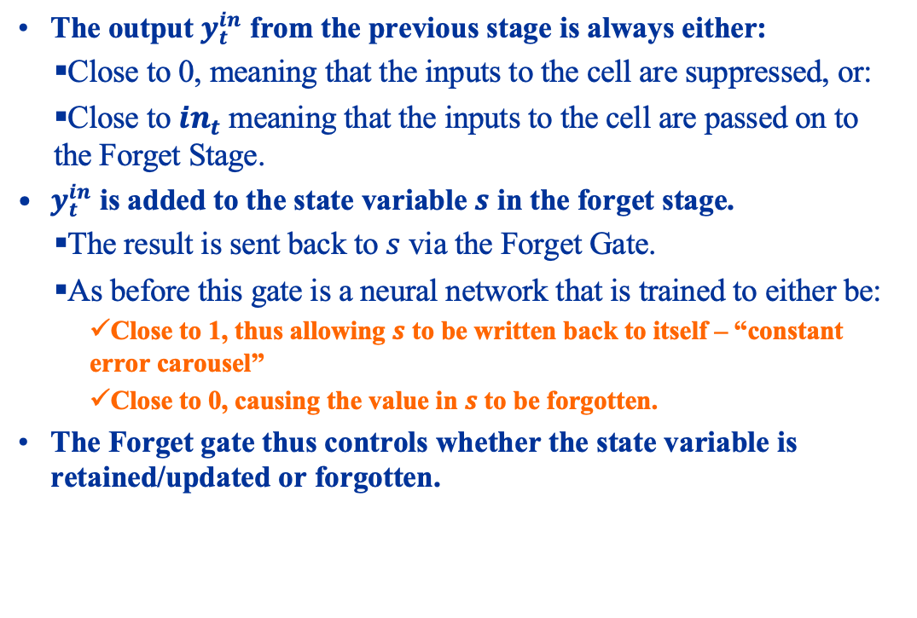
LSTM Cell Forget Gate (Constant Error Carousel)
The output $y_{t}^{in}$ from the previous stage is always either:
Close to 0, meaning that the inputs to the cell are suppressed, or:
Close to ${in}_{t}$ meaning that the inputs to the cell are passed on to the Forget Stage.
$y_{t}^{in}$ is added to the state variable $s$ in the forget stage.
The result is sent back to $s$ via the Forget Gate.
As before this gate is a neural network that is trained to either be:
Close to 1, thus allowing $s$ to be written back to itself – “constant error carousel”
Close to 0, causing the value in $s$ to be forgotten.
The Forget gate thus controls whether the state variable is retained/updated or forgotten.

Slide 15
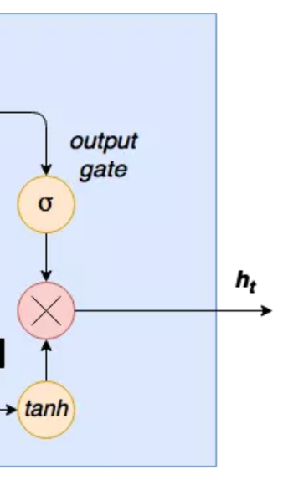
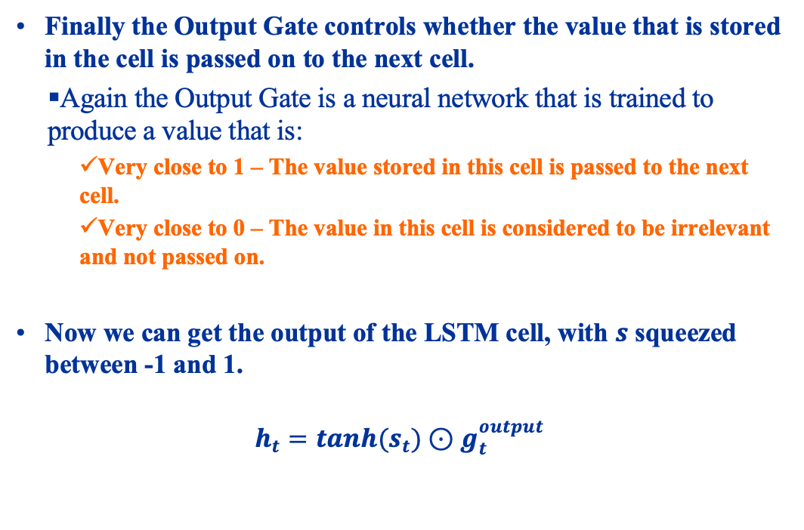
LSTM Cell Output Stage
Finally the Output Gate controls whether the value that is stored in the cell is passed on to the next cell.
Again the Output Gate is a neural network that is trained to produce a value that is:
Very close to 1 – The value stored in this cell is passed to the next cell.
Very close to 0 – The value in this cell is considered to be irrelevant and not passed on.
Now we can get the output of the LSTM cell, with $s$ squeezed between -1 and 1.
$$h_{t}=tanh(s_{t})⊙g_{t}^{output}$$

Slide 16
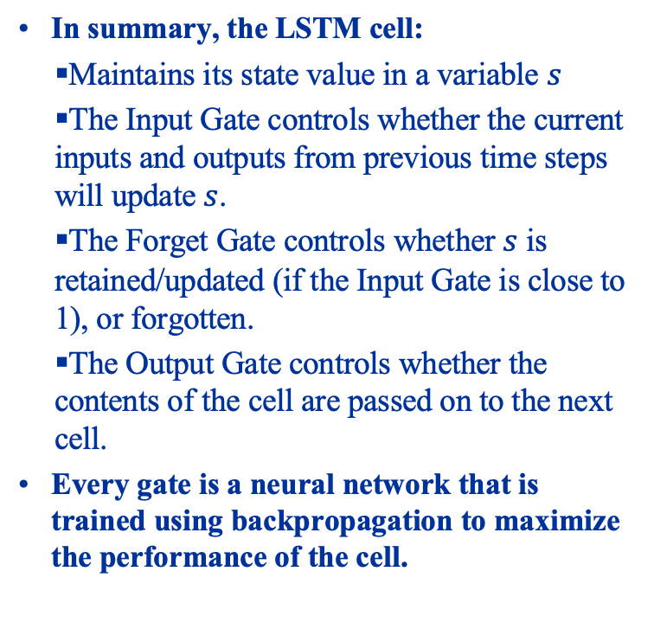
LSTM Cell Summary
In summary, the LSTM cell:
Maintains its state value in a variable $s$
The Input Gate controls whether the current inputs and outputs from previous time steps will update $s$.
The Forget Gate controls whether $s$ is retained/updated (if the Input Gate is close to 1), or forgotten.
The Output Gate controls whether the contents of the cell are passed on to the next cell.
Every gate is a neural network that is trained using backpropagation to maximize the performance of the cell.

Slide 17
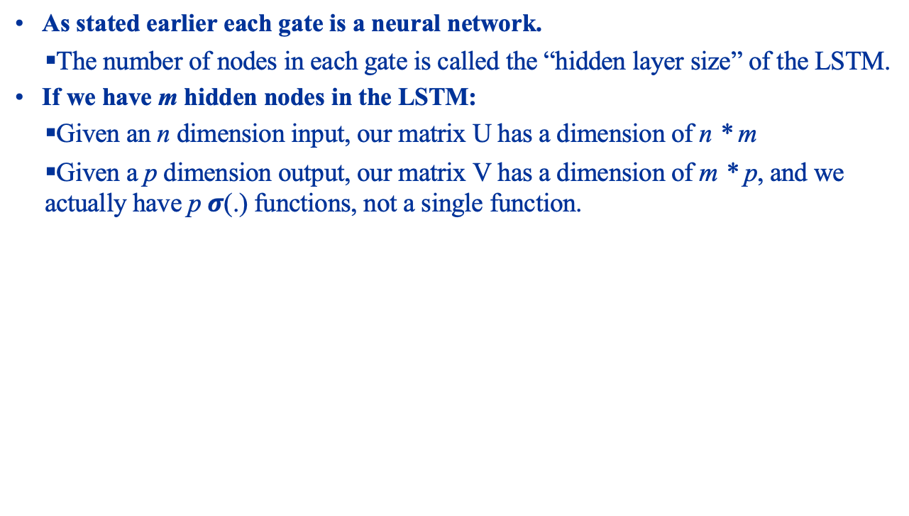
LSTM Hidden Layer Size
As stated earlier each gate is a neural network.
The number of nodes in each gate is called the “hidden layer size” of the LSTM.
If we have m hidden nodes in the LSTM:
Given an n dimension input, our matrix U has a dimension of n * m
Given a p dimension output, our matrix V has a dimension of m * p, and we actually have p $σ$(.) functions, not a single function.

Slide 18
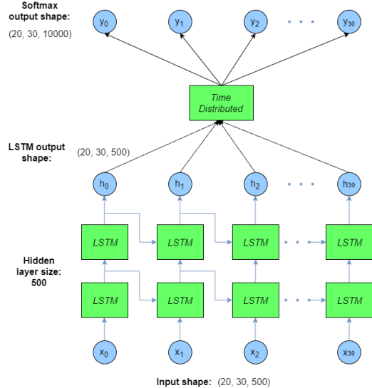
Using the LSTM Cells
The diagram below shows one way we can use an LSTM cell:
Each cell produces one time step, and feeds the next cell, together with the input for that time step.
We can stack LSTMs to increase learning power, and connect Dense layers to learn patterns, etc. from the time-stepped data.

Slide 19
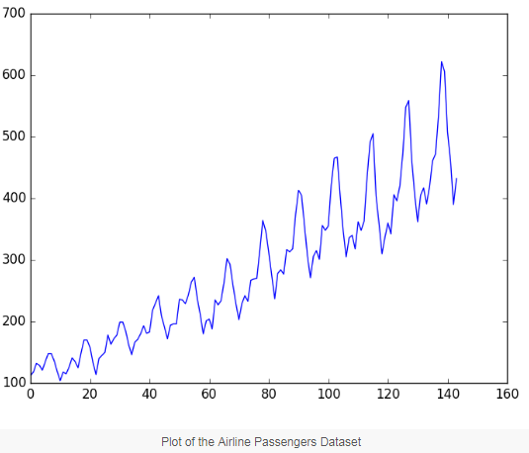
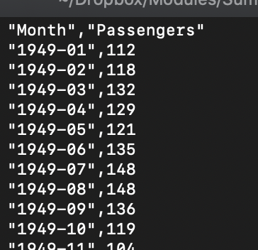
Using LSTMs in Keras
To see how to use LSTMs in Keras, we will use LSTMs to model the growth in airline passenger traffic from January 1949 to December 1960, shown below:
The idea is to learn the data to make predictions about passenger traffic in the next month.

Slide 20
LSTM Hands On
Load up lstm.ipynb in Jupyter

Slide 21
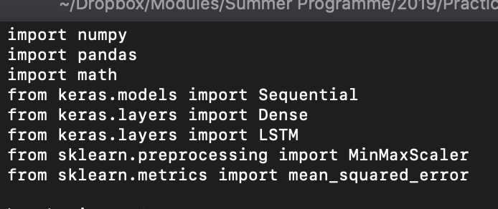
Using LSTMs in Keras Imports
Additional explanation for the Python notebook.
We begin firstly with all the imports:
Here we bring in the LSTM layer for us to build our LSTM network, as well as a Dense layer that we will use to predict growth of airline passenger traffic based on past data.
We also bring in a MinMaxScaler that will scale our data into the [0, 1] range.

Slide 22
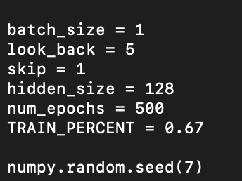
Using LSTMs in Keras Training Hyperparameters
Now we create some constants, and seed the random number generator so that we get reproducible random numbers:
The constants are:
Batch_size = # of pieces of data presented each time for training, look_back = the time span we are learning from (i.e. current time and previous 5 time periods), skip = # of time steps to advance each time, hidden_size = # of neurons in each part of the LSTM. The rest are self-explanatory.

Slide 23
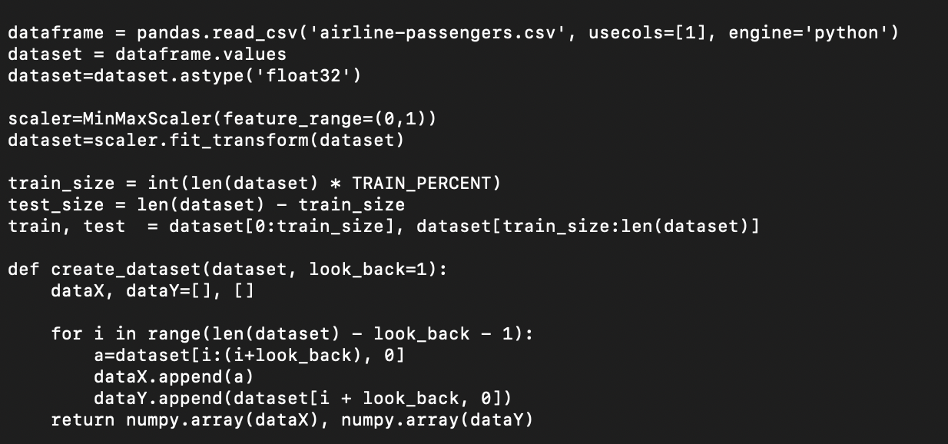
Using LSTMs in Keras Creating the Dataset
We now load the data using Pandas, scale the data to between 0 and 1, then partition the data into training and testing data. We also make a “create_dataset” function.

Slide 24
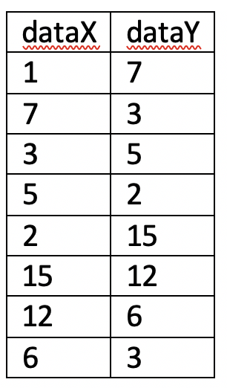
Using LSTMs in Keras Creating the Dataset
The “create_data” function creates a sliding window of data, depending on the value of look_back. If we use a look_back of 1 on the data series “1, 7, 3, 5, 2, 15, 12, 6, 3”, then we get a table like:
So dataY is always one step after the current position in dataX.

Slide 25
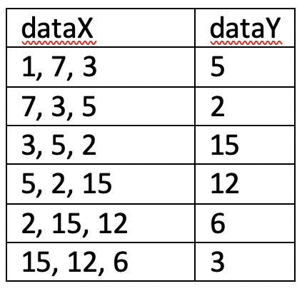
Using LSTMs in Keras Creating the Dataset
If we use a look_back of 3, we get:
Notice that dataX is now a vector of 3 values, while dataY is the next value.

Slide 26
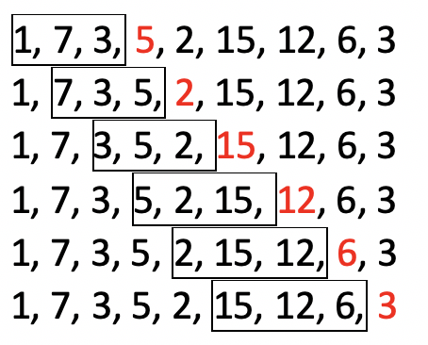
Using LSTMs in Keras Creating the Dataset
The diagram below gives a clearer picture:
The window shows the current X values being considered, while the red values are the next value, which are to be predicted.

Slide 27
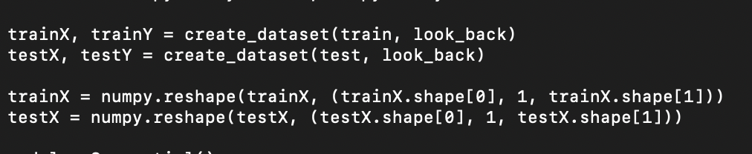
Using LSTMs in Keras Reshaping the Datasets
Since our LSTM is using just a single input (passenger data), our LSTM will have a single input, each input consisting of “look_back” entries. Our training data must be reformatted to match this:

Slide 28
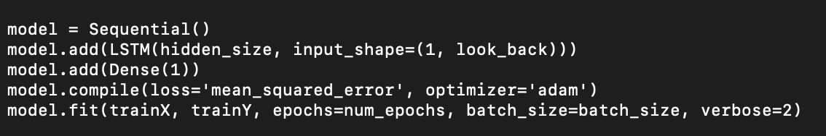
Using LSTMs in Keras Building the LSTM
Now we are finally able to build our LSTM. We will use the LSTM layer in Keras to do this. We also need a dense layer to take the LSTM outputs and produce a single output – our prediction of passenger volumes. Then we add an Adam optimizer and call fit to train the LSTM:
Each gate of the LSTM it itself a neural network, each with “hidden_size” nodes. It expects inputs to be of the shape (1, look_back):
This means it expects a single variable input, each consisting of “look_back” entries.

Slide 29
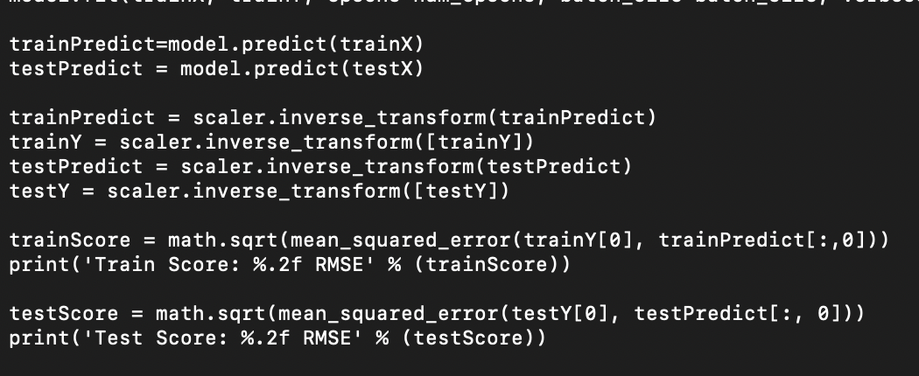
Using LSTMs in Keras Evaluating
Finally we call predict to predict the next value, and use reverse_transform to map back from the [0, 1] range to the range of our original data. We then compare against the training and test data to see the root mean squared error (RMSE):

Slide 30
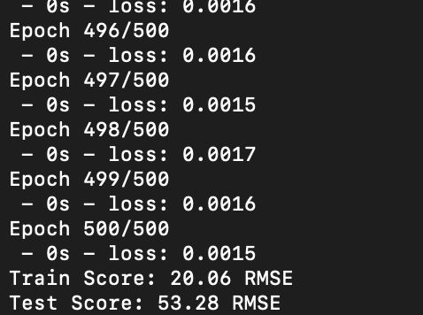
Using LSTMs in Keras Evaluating
When run you will see:

Slide 31
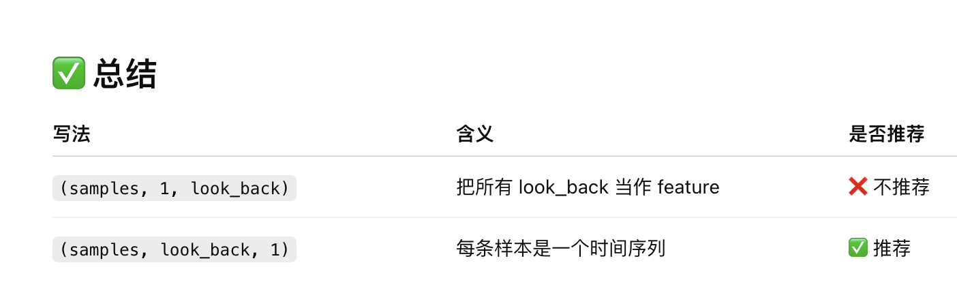
Using LSTMs in Keras Swapping Dimensions
One of LSTM’s strengths is its ability to remember across training batches. We will now see how to do this. Before we start:
It is more intuitive to think of look_back time steps of a single input, rather than single inputs of look_back time steps. So locate these lines:
And change them to:

Slide 32
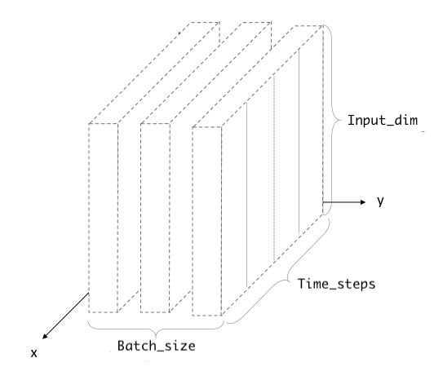
Using LSTMs in Kerass Why swap dimensions?
LSTM expects the third dimension to be the input features, NOT the look back.
In our original code we had swapped this around so that the third dimension was the look back, and the second dimension was the input features.
We swapped this back the right way in our second version of the code.

Slide 33
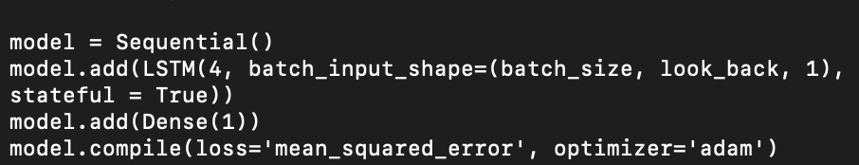
Using LSTMs in Keras Using Memory
To use memory we need to organize the data into batches, and to turn on the ‘stateful’ flag in LSTM. So change:
To:
Note that we have also flipped the input from 1, look_back to look_back, 1, and reduced the number of hidden nodes in the LSTM.

Slide 34
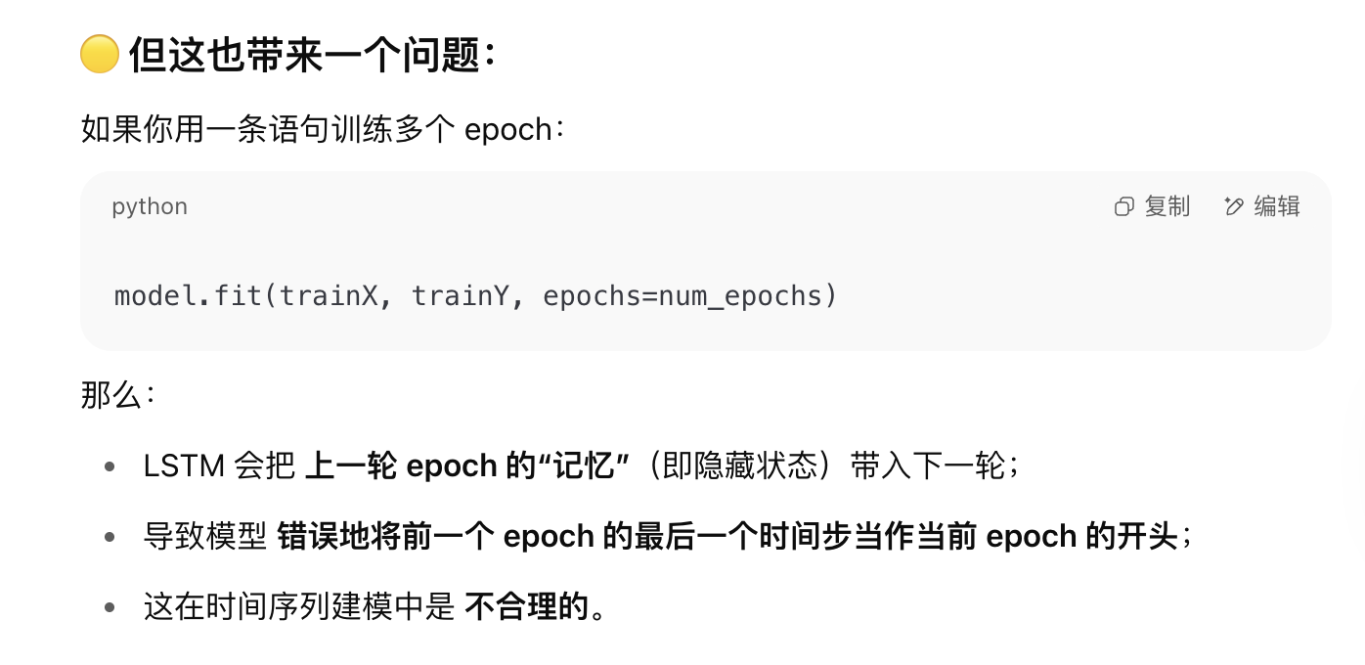
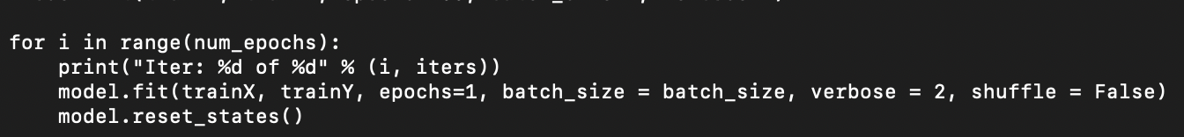
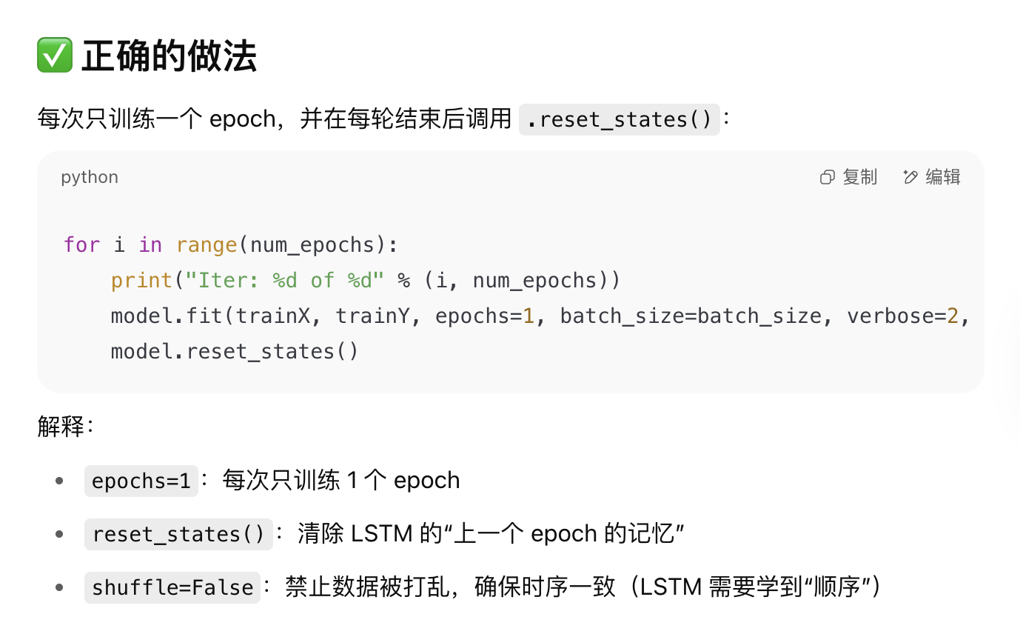
Using LSTMs in Keras Using Memory
We also need to change the model.fit call to run one epoch at the time, because we need to call reset_states(), so that the LSTM knows it is getting a fresh batch of inputs.
Otherwise the LSTM will wrongly tie the end of the previous epoch with the start of the next epoch.
Change:
To:
Note that you MUST turn off shuffling, as we need to present the data sequentially as they occur for the LSTM to learn across them properly.

Slide 35
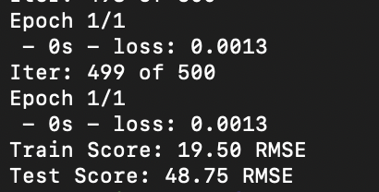
Using LSTMs in Keras Using Memory
When we run our new lstm1.py program, we see:
We see that the results have improved from 20.06 RMSE and 53.28 RSME for inside and outside testing respectively, to 19.50 and 48.75.
In the next lab we will look at how to stack LSTMs to get better results.

Slide 36
transformers
SWS3009 Embedded Systems and Deep Learning.

Slide 37
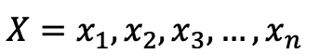
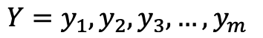
Transformers - Introduction
Materials for this section taken from “Transformers: A Primer”
URL: http://www.columbia.edu/~jsl2239/transformers.html
The Transformer architecture was motivated primarily by the language translation problem:
Given a statement X consisting of a sequence of words in the source language:
Find the equivalent statement Y in the target language:
This has some complications: Notably, words in the source language do not translate directly to words in the target language.
Some phrases may translate to single words and vice-versa.

Slide 38
Transformers - Introduction
One effective way to do machine translation is to have two people who speak a common language C. i.e.
Person 1 speaks languages A and C
Person 2 speaks languages B and C.
Person 1 translates statement X to statement Z into language C.
Person 2 translates statement Z in language C to statement Y in language B.
This is known as an “encoder-decoder” architecture, which most language translation systems use:
The encoder neural network translates from statement X to a vector Z – “latent space”
The decoder neural network translates from vector Z to statement Y
Encoder-Decoder architectures are also very popular in generative networks
We will cover these in Lecture 2.

Slide 39
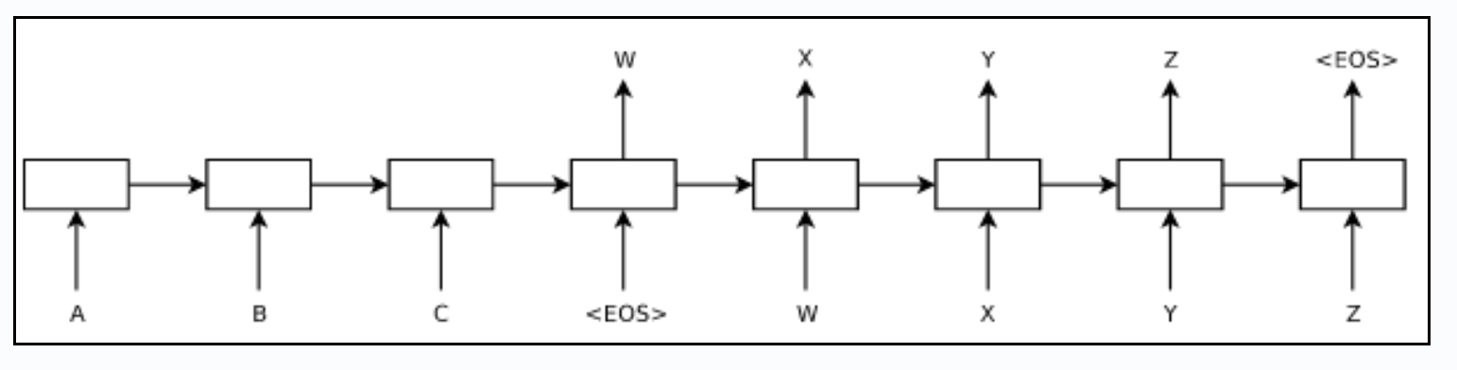
Transformers - Introduction
Earlier efforts made use of RNNs (including LSTMs) to build the encoder and decoder.
Statements were terminated with an end-of-statement symbol <EOS>
A statement X is then encoded to Z, and at the <EOS> symbol, Z is translated to Y.

Slide 40
Transformers - Introduction
To perform translation:
Encoding:
The first word x₁ is fed into the encoder RNN f_{x} together with an initial hidden vector z₁. This RNN generates an output vector and a new hidden vector z₂.
Word x₂ is fed to the RNN together with z₂ to produce z₃, etc. All outputs except the various z vectors are ignored.
By the time the last word x_{n} is fed in, the vector z_{n} contains all the information needed for the decoder to translate to the target language.
The <EOS> symbol is fed in to generate z_{n+1}
Decoding:
The final vector z_{n+1} is then fed into the decoder together with <EOS>, and the target first word y₁ as the “ground truth” on what to produce.
y₁ is then fed in with y₂ as the ground truth, etc., until word y_{n} with <EOS> as the ground truth.
In this way the system learns from translate from X (encoded in h_{n+1}) to Y.

Slide 41
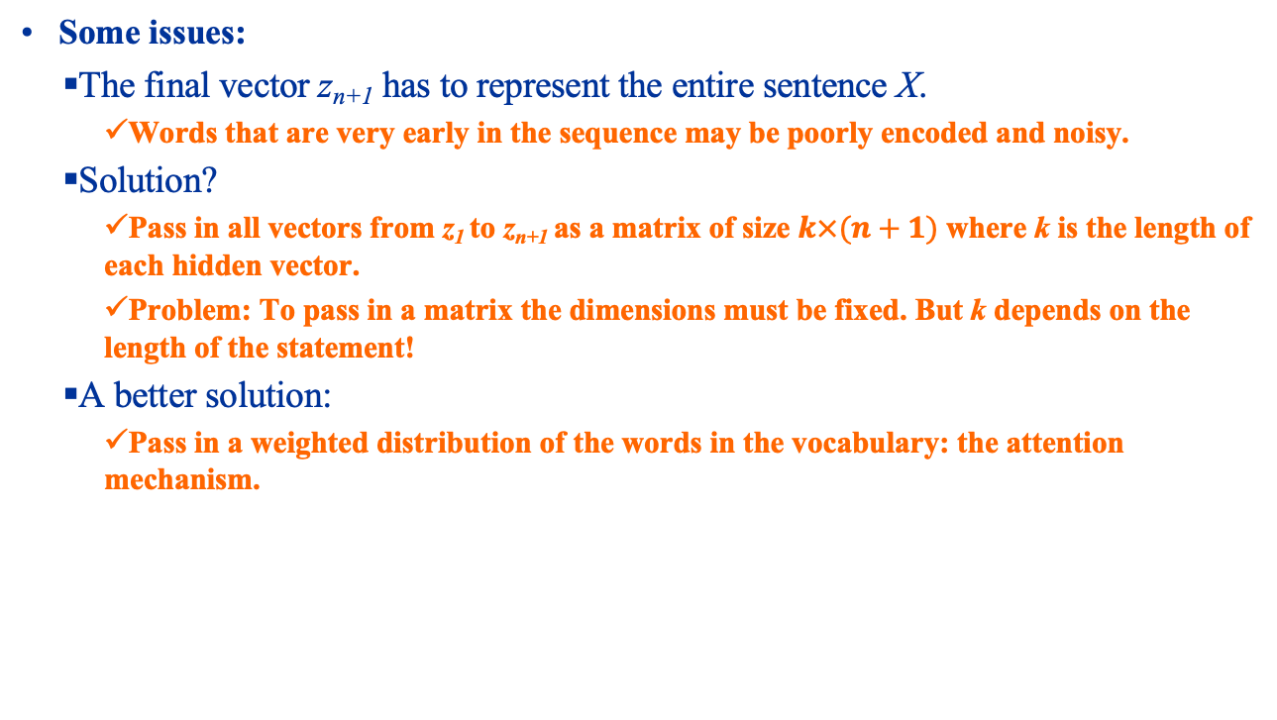
Transformers - Introduction
Some issues:
The final vector z_{n+1} has to represent the entire sentence X.
Words that are very early in the sequence may be poorly encoded and noisy.
Solution?
Pass in all vectors from z₁ to z_{n+1} as a matrix of size $k×(n+1)$ where k is the length of each hidden vector.
Problem: To pass in a matrix the dimensions must be fixed. But k depends on the length of the statement!
A better solution:
Pass in a weighted distribution of the words in the vocabulary: the attention mechanism.

Slide 42
Transformers - Introduction
We are going to look at transformers in the context of text generation (e.g. in ChatGPT or DeepSeek).
Text sentences consist of words. E.g. “This is a text sentence.”
Our neural networks are numerical and cannot process text.
Common approach:
Put all the words in our vocabulary into a dictionary.
Replace each word with its index number in the dictionary.
Our sentence above then might become 5 25 3 30 4, where each number represents the position of the word within the dictionary. This is known as “bag of words” or BOW.

Slide 43
Transformers - Introduction
BOW has several problems.
The numbers assigned to each word is arbitrary – usually the order in which the word was added to the dictionary.
This arbitrariness also means that words that are close together in the dictionary (e.g. words 3 and 8) are not necessarily any more relevant to each other than words far apart (e.g. words 3 and 3500).
In a large vocabulary with (say) 10,000 words, a sentence would only contain around 8 to 10 of these words – very sparse representation.

Slide 44
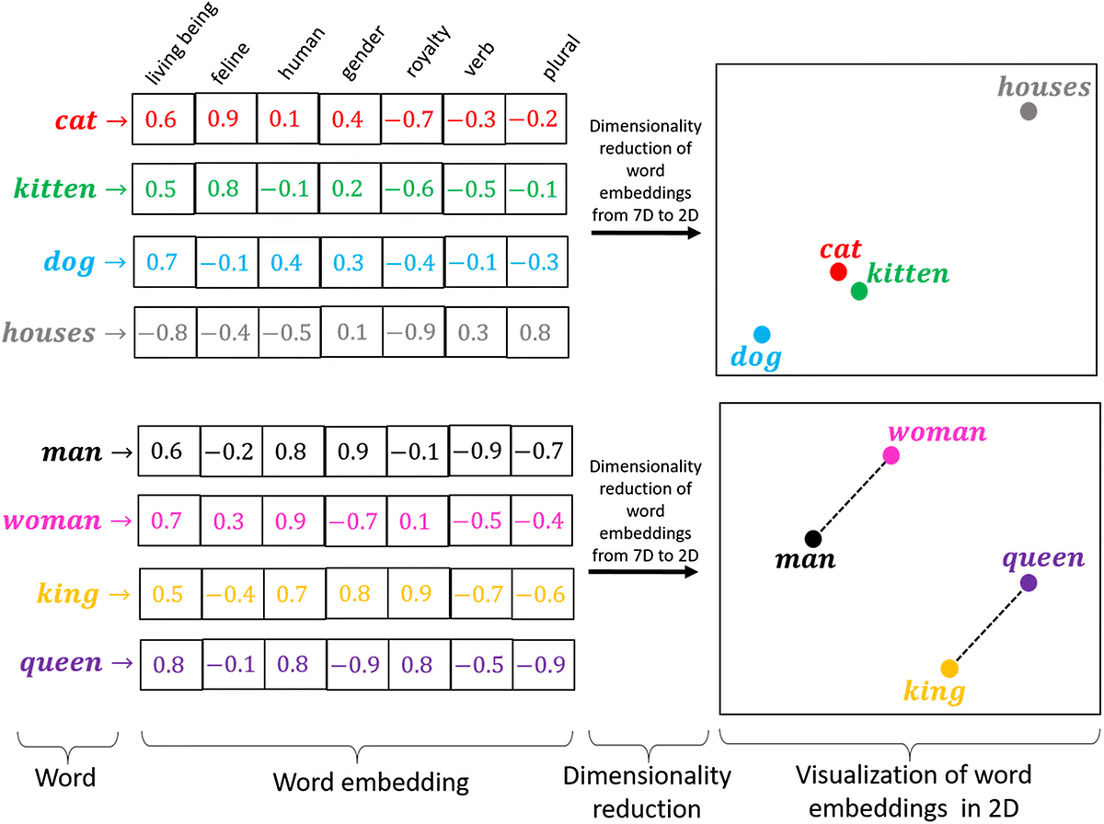
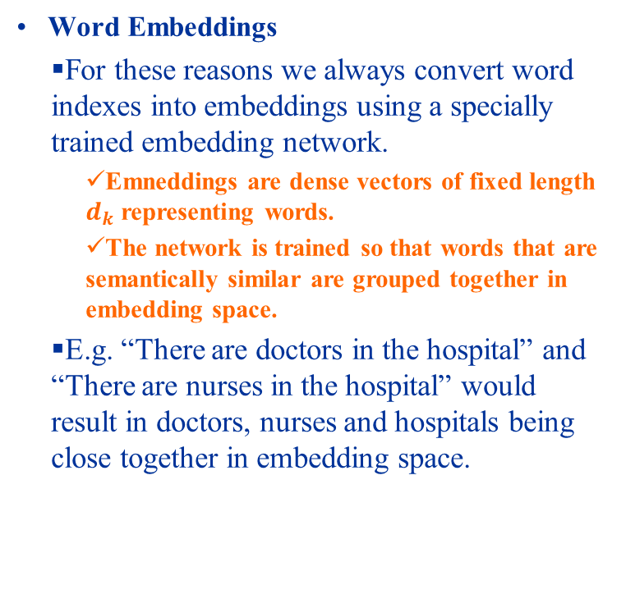
Transformers - Introduction
Word Embeddings
For these reasons we always convert word indexes into embeddings using a specially trained embedding network.
Emneddings are dense vectors of fixed length $d_{k}$ representing words.
The network is trained so that words that are semantically similar are grouped together in embedding space.
E.g. “There are doctors in the hospital” and “There are nurses in the hospital” would result in doctors, nurses and hospitals being close together in embedding space.

Slide 45
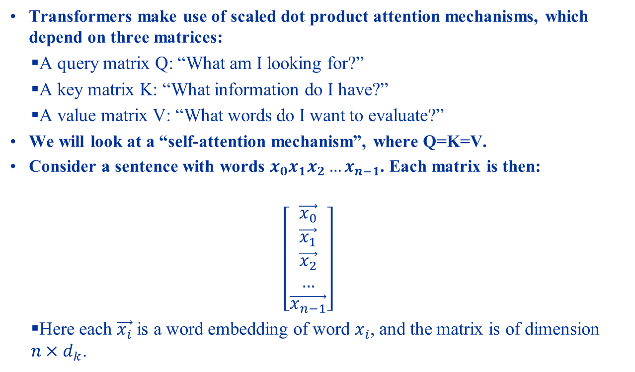
Transformers - Introduction
Transformers make use of scaled dot product attention mechanisms, which depend on three matrices:
A query matrix Q: “What am I looking for?”
A key matrix K: “What information do I have?”
A value matrix V: “What words do I want to evaluate?”
We will look at a “self-attention mechanism”, where Q=K=V.
Consider a sentence with words $x_{0}x_{1}x_{2}…x_{n−1}$. Each matrix is then:
$$\left[\begin{aligned}\vec{x_{0}} \\ \vec{x_{1}} \\ \vec{x_{2}} \\ … \\ \vec{x_{n−1}}\end{aligned}\right]$$
Here each $\vec{x_{i}}$ is a word embedding of word $x_{i}$, and the matrix is of dimension $n×d_{k}$.

Slide 46
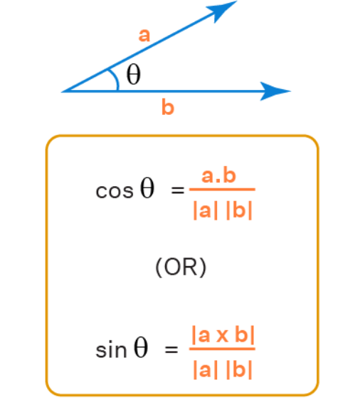
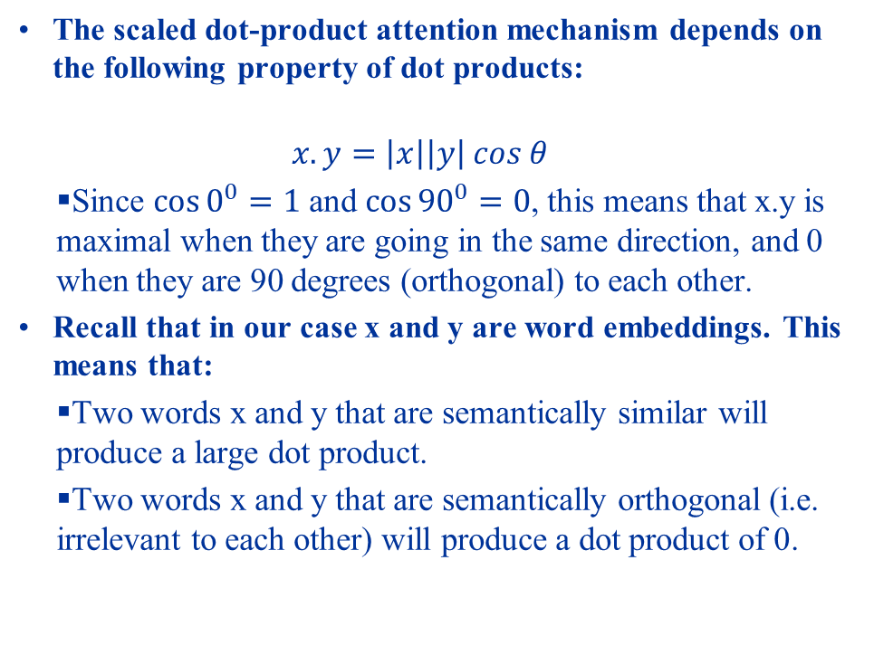
Transformers - Introduction
The scaled dot-product attention mechanism depends on the following property of dot products:
$$x.y=\left|x\right|\left|y\right| cos θ$$
Since $\cos{0^{0}=1}$ and $\cos{{90}^{0}}=0$, this means that x.y is maximal when they are going in the same direction, and 0 when they are 90 degrees (orthogonal) to each other.
Recall that in our case x and y are word embeddings. This means that:
Two words x and y that are semantically similar will produce a large dot product.
Two words x and y that are semantically orthogonal (i.e. irrelevant to each other) will produce a dot product of 0.

Slide 47
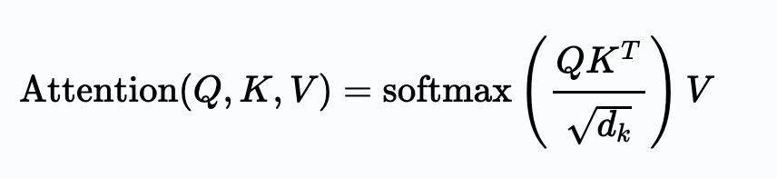
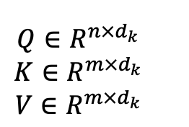
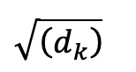
Transformers – Attention
The most common attention mechanism is the scaled dot product attention, given by:
Here Q is the query matrix, K is the key matrix, V is the value matrix, and d_{k} is the length of dimensionality of the matrices:
The Q, K and V matrices depend on what we are trying to do. In particular, when Q = K = V, we get “self attention”.
The division by mitigates the effects of large input values, which leads to smaller gradients. See link for details.

Slide 48
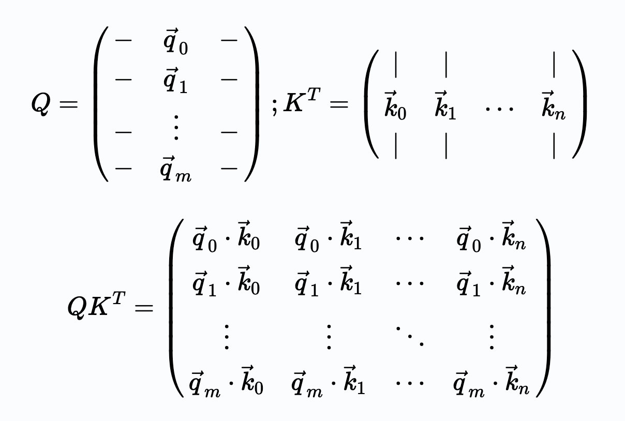
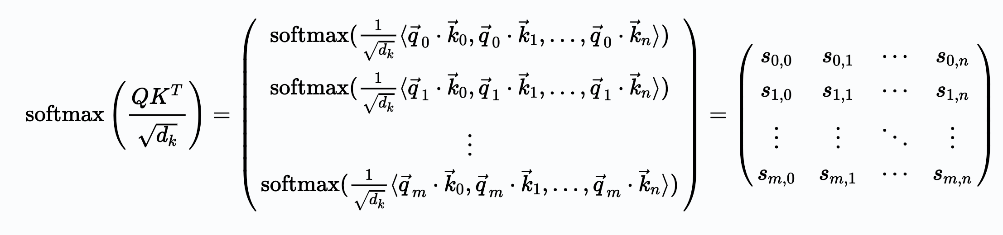
Transformers – Attention
Let’s multiply out the softmax(.) part of the equation. This gives us:
Adding in the softmax gives us:

Slide 49
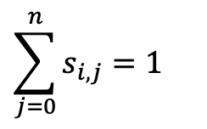

Transformers – Attention
Note that due to the softmax:
Now we multiply in V:

Slide 50
Transformers – Attention
We can see that the end result of the attention mechanism is a weighted sum of each element of V, where the weights are determined by Q and K.
In particular the closer some q_{i}k_{j} is, the greater the weight for v_{i}. See the link for an explanation.
The attention mechanism relates words that are within the same sentence and across sentences, resolving the issue with RNN models.

Slide 51

Transformers – The Transformer Block
A Transformer is made of Transformer blocks. Each block:
Has a multihead attention block.
An ”add and norm” block that adds the input to the Transformer Block with the output of the multihead attention block and normalizes it.
Passes this to the feedforward neural network.
Produces an output that adds that the output of the feedforward neural network to the previous ”add and norm” and normalizes it.
These blocks may be stacked multiple times in the encoder and decoder.

Slide 52
Transformers – The Transformer Block
Some details:
Multihead Attention Block:
Several linear transformations are applied to Q, K and V.
Scaled dot-product attention is then applied to each transformed version.
The results are concatenated into a single matrix.
Purpose is to discover other aspects of the inputs.
Input and positional embedding:
Input encoding converts words into vectors.
Positional encoding shows the positions of the words.

Slide 53

Transformers – The Transformer Block
Some details:
Masked multihead attention: Since the decoder will not in reality know the next word, when decoding future words are “masked”
Implemented as a lower triangular matrix where the lower diagon is all ‘1’ and the upper diagonal is all ‘0’.

Slide 54
Transformers
Keras does not have Transformer models per-se; you need to build them yourselves:
However it does have a multihead attention block.
Transformer code shown in transformer.ipynb.

Slide 55

Transformers: Main Transformer Block

Slide 56

Transformers: Token and Position Embedding

Slide 57

Transformers: Sentiment Analysis

Slide 58
Convolutional neural networks
SWS3009 Embedded Systems and Deep Learning.

Slide 59

Convolutional Neural Networks Revision: What is a CNN?

Slide 60



Convolutional Neural Networks Convolution Layers
The CNN’s primary distinguishing feature is the convolution layer.
Made up of kernels that convolve over the input and over each other.

Slide 61

Convolutional Neural Networks Convolution Layers
The depth of the kernel is equal to the depth of the data. E.g. with color images there are 3 channels, and the kernel is 3 layers deep:

Slide 62
Convolutional Neural Networks Convolution Layers
The kernels function as feature extractors and the output from the convolution operation is called a “feature map”
As training progresses the kernels become optimized to extract key information like edges, repeating patterns, etc. in the input data.
Many kernels can be used on one layer.
This will produce a volume of feature maps instead of a single feature map.
Due to the randomness of the initial kernel, each feature map ends up extracting a different feature of the input.

Slide 63
Convolutional Neural Networks Convolution Layers
You can convolve kernels over earlier kernels.
The feature maps generated will represent higher level features of the input.
E.g. the lower kernel might extract lines, the higher kernel might extract shapes.

Slide 64
Convolutional Neural Networks Convolution Layers
Convolution Kernel Hyper-Parameters:
Size:
E.g. 3x3, 5x5, 9x9
Typically smaller kernels extract more refined features at the expense of higher computational costs. Can be more sensitive to noise.
Larger kernels use less computational power but produce features of lower resolution.
Stride:
The # of steps a kernel moves to the right or down each time.
Smaller strides capture more data but also produce larger feature maps.
Larger strides produce smaller feature maps but lose more data.
Padding:
What do we do when we reach the end of the input data and part of the kernel “hangs out” over the edge?
Keras supports a “same” padding that preserves the size of the input. Other choices may increase or decrease the size of the input.

Slide 65
Convolutional Neural Networks Convolution Layers in Keras
Keras offers many types of convolution layers: https://keras.io/layers/convolutional/
padding:
‘valid’: Convolution stops when the right/bottom edge of the filter hits the right/bottom edge of the input data. Will create a feature map smaller than the input
‘same’: Input is padded with ‘0’ to allow the feature map to be the same size as the input.
activation:
If None, Keras will use an identify activation. I.e. id(x) = x, where x is the feature map computed by the convolution operation.
Otherwise can specify other activations like ReLU, tanh etc.
kernel_size:
Size of the kernel window. E.g. (3, 3) makes a 3x3 filter
filters: Number of kernels to make.

Slide 66
Convolutional Neural Networks Pooling Layers
The pooling layer takes a n x n region of the feature map and either picks the maximum or takes an average:
Pooling layers:
Reduce dimensionality and hence computing power.
Extracts the most dominant features (max pooling):
Makes the model shift invariant and less noise sensitive
averages the features (average pooling)
Reduces the effect of noise by averaging it out – white noise has an average of 0.

Slide 67
Convolutional Neural Networks Pooling Layers
Pooling layer hyperparameters:
stride: As with the convolution layer, this determines the number of steps the pool moves each time to the right or down.
size: Controls the dimensionality reduction.
Generally if stride = size, the feature map is reduced by 1/size in each dimension.
Keras pooling API: https://keras.io/layers/pooling/
pool_size: The length or dimensions of the pool.
strides: As described above.
Generally the first few (or many?) layers of the CNN consist of alternating convolution and pooling layers:
CNN 的前几层会交替堆叠卷积层和池化层
However stacking too many pooling layers can result in losing all data.

Slide 68

Convolutional Neural Networks Flatten Layer / Example
The Flatten layer turns the feature maps into a 1D vector for feeding into the Dense layers.
Example:

Slide 69
object detection
SWS3009 Embedded Systems and Deep Learning.

Slide 70

Object Detection
The CNNs we saw earlier are very good at recognizing single objects in pictures like this – the object is large and relatively isolated.

Slide 71

Object Detection
However it doesn’t perform as well in pictures like this, where there are many objects:

Slide 72

Object Detection
We very often also want to locate and identify many objects at once, e.g. when building autonomous vehicles:

Slide 73
Object Detection
There are several ways to solve this problem. One popular way:
Pre-train a classifier (e.g. CNN) to recognize various objects.
Divide up the image into multiple regions.
Perform classification in each region.
Many object detection algorithms follow this method:
Regions with CNN Features (RCNN)
Fast RCNN, Faster RCNN
Single-Shot Detector (SSD)
In the following sections we assume that the input to each network is an image with multiple objects to be ”localized” and “classified”.
“Localized” – Where is the object?
“Classified” – What is the object?
For training, each object is assumed to have a bounding box called “GT” – short for “Ground Truth”

Slide 74

Object Detection
Localization goodness-of-fit metric: Intersection over Union (IoU)
We measure how well the algorithm’s bounding box (BB) for each object overlaps with GT:

Slide 75

Object Detection – RCNN
In RCNN:
A fixed (non-trainable) algorithm scans the image for possible objects:
Creates proposed bounding boxes for each region that the algorithm thinks there is an object.
Returns bounding boxes with high object scores as “Regions of Interest” or ROIs.
A feature extractor (convolution/pooling layers of an image classifier) then generates classification information for each ROI
A CNN (“classification head”) uses this information to classify objects in each ROI.

Slide 76
Object Detection – Fast RCNN
RCNN is very slow:
Many overlapping ROIs generated for each image, resulting in many passes through the feature extractor and classifier.
Each image took 47 seconds to process.
Fast RCNN:
Similar to RCNN, except that the output of the feature extractor goes to a classification head and a box regression head.
The regression head predicts the size and centre of the object, to reduce the number of ROIs to be processed.
150x speed improvement over RCNN.
Faster RCNN:

Slide 77

Object Detection – Faster RCNN
Faster RCNN
ROI proposal module is eliminated, entire image and not just ROIs are fed to the feature extractor.
Box regression head replaced with a region proposal network (RPN):
Trained to generate region proposals and object scores.
An algorithm then loops through the proposed regions and picks the best.

Slide 78

Proposing Bounding Boxes
Each output of the RPN is given a set of bounding boxes in different heights and widths - “Anchors”
The network then learns how to select and transform the anchor to best capture the object.
”Non-maximal suppression” (NMS) is then performed:
IoU for pairs of bounding boxes is performed.
If there is a pair with very high IoU we assume that they bound the same object - the bounding box with the lower confidence score is discarded
Expensive: O(n²)

Slide 79


Object Detection – Single Shot Detector (SSD)
In SSD:
Image passes through a feature extractor and produces an $m×n$ feature map.
Feature extractor usually comes from the convolution/pooling layers of a pre-trained VGG network.
Each cell of the feature map has k anchors.
For each anchor in each cell:
Produces c classification scores and 4 possible offsets for each anchor.
Thus we have $\left(c+4\right) × k × m × n$ possible scores
因为 feature map 上有 m×n 个 cell，每个 cell 有 k 个 anchor
The best score is picked for the classification and localization using NMS

Slide 80

Object Detection – You Only Look Once (YOLO)
The YOLO algorithm uses a single CNN to generate classification and localization data for each object:
20 layers of convolutions, Average Pooling and dense layer trained on ImageNet dataset.
4 convolution and 2 dense networks added for classification.
Final layer produces classification and bounding box scores.
Non-maximal suppression removes redundant boxes with large overlaps.
Very fast object detection with high accuracy – Considered state of the art.

Slide 81
Object Detection – You Only Look Once (YOLO)
There are no standard YOLO libraries implemented in Keras:
You are provided with several Python scripts that contain a YOLO implementation.
Complex, will not be covered here.

Slide 82
Summary
In this lecture we looked a group of deep learning networks:
LSTMs and Transformers, good for analyzing sequences of data.
CNNs, good for classifying images.
YOLO, good for localizing and classifying multiple objects in an image/video.
These networks form the basic toolkit that you will use for your robots.
LSTMs, Transformers: Good predicting sequences, or for learning paths
CNNs: Good for identifying objects, people, etc.
YOLO: Good for identifying objects and their positions, for object avoidance, to seek objects, etc.
In Lecture 3 we will look at Statistical Methods, which are simpler versions of what we did in this lecture.
In the next lecture we will look at Generative Networks. These are excellent for:
Generating new data for training.
Generating imagined scenarios based on real-world scenarios, to improve planning.
…

